Slide 1
Analyzing Sports Articles for Objectivity
Benjamin Garcia

Slide 2
Research Question
Given various sports articles, what can quantitative characteristics about the articles tell us about the objectivity of the article?

Slide 3
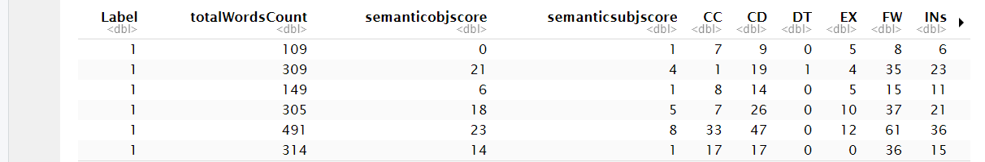
The Dataset
1,000 observations each corresponding to a sports article
61 columns or predictors each describing an aspect of the grammar or style of the sports article
Target variable (Label) indicates whether the sports article is objective or subjective
Source: https://archive.ics.uci.edu/dataset/450/sports+articles+for+objectivity+analysis

Slide 4
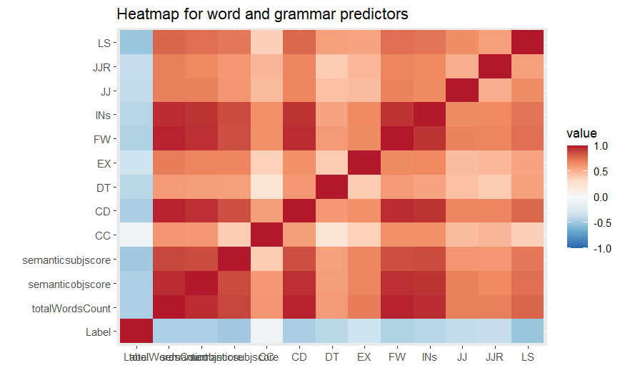
Data Preparation
Removed variables that were sparse or contained primarily the same value
Changed target variable from character variable labeled objective/subjective to binary categorical variable 1/0
Removed highly correlated predictors
22 predictors remained
Scaled remaining predictors
Data split into training and holdout

Slide 5
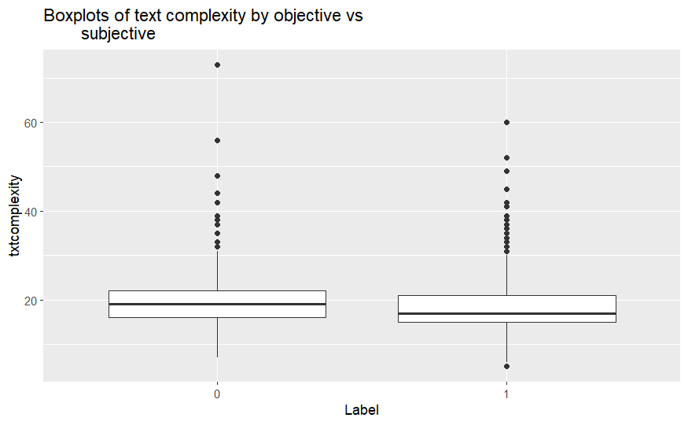
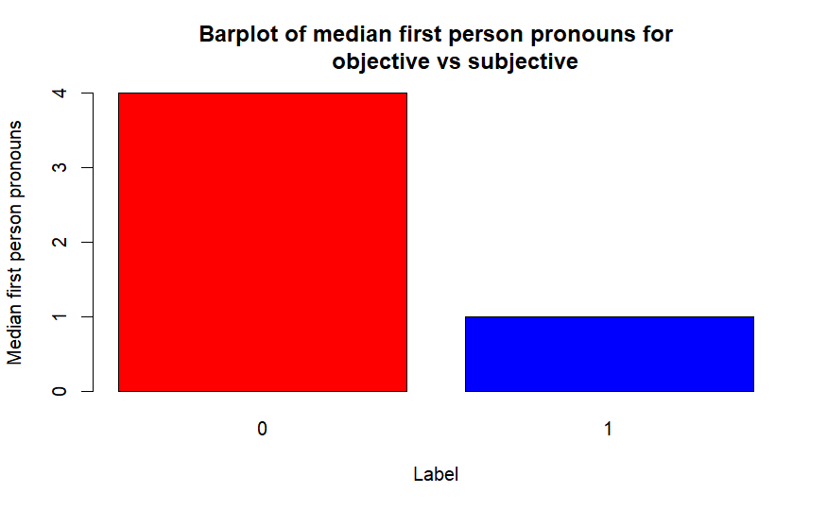
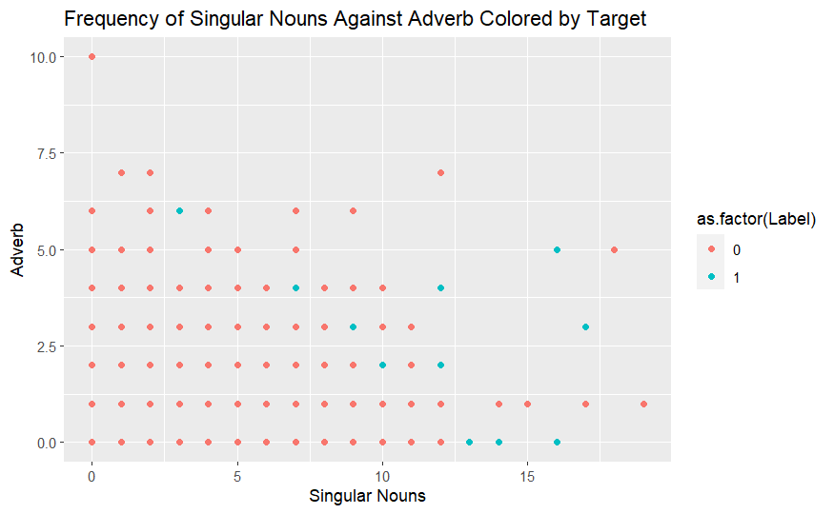
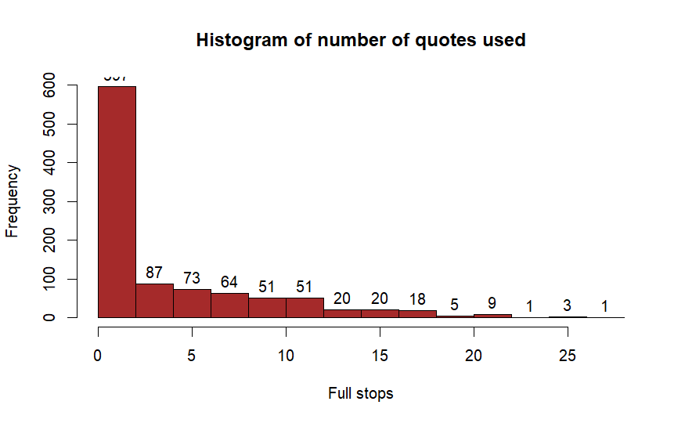
Exploratory Data Analysis

Slide 6
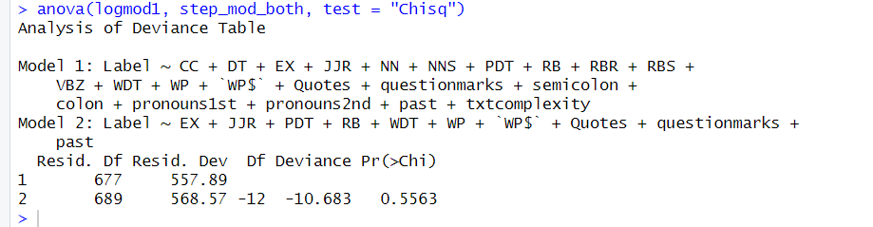
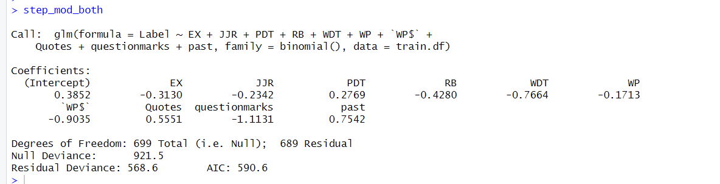
Logistic Regression
The logistic regression model using all the predictors had an AIC of 603.89
Applying forward-backward stepwise regression reduced the AIC to 590.6 and the number of predictors to 10
Doing an ANOVA using a Chi-square test comparing the full and reduced model showed that the reduced model holds better in comparison

Slide 7
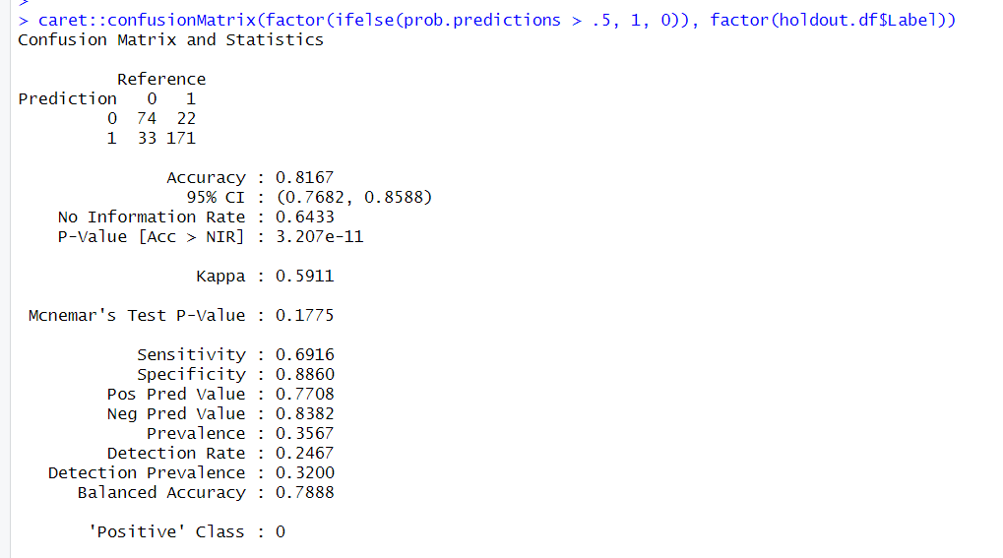
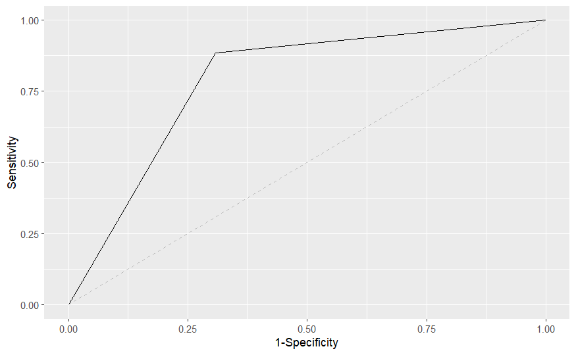
Logistic Regression
Accuracy on the holdout data was .8167
The AUC for the ROC curve was about .79

Slide 8
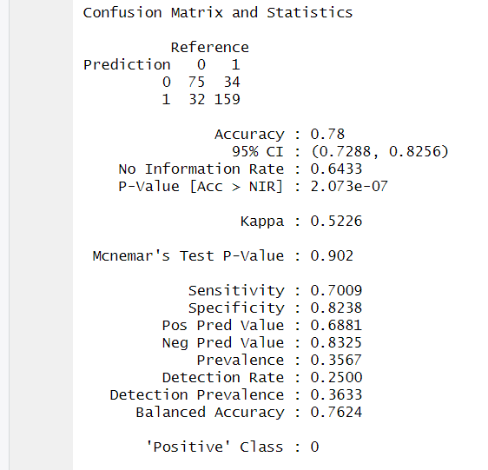
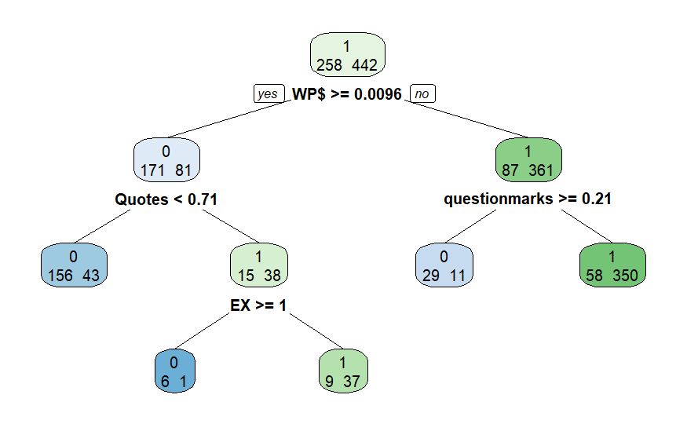
Decision Tree
Used the 10 significant variables found from stepwise regression to build a decision tree.
Pruned the first tree by using the cp with the lowest xerror or cross-validation error
.78 accuracy on holdout data

Slide 9
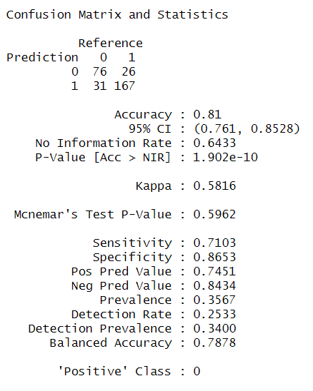
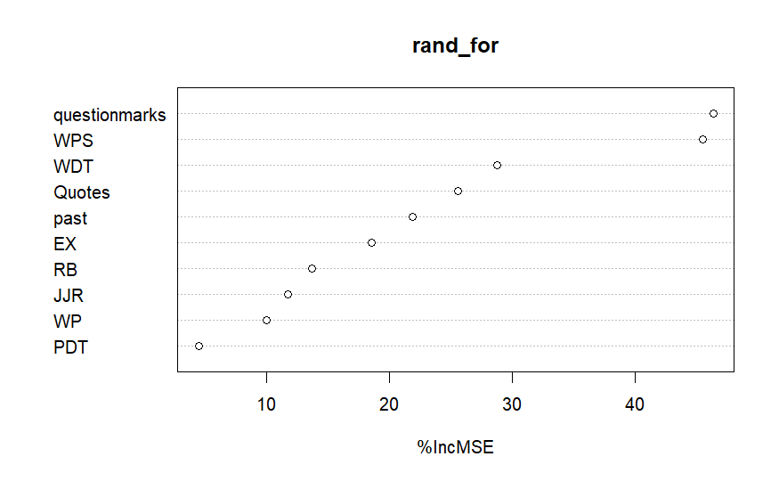
Random Forest
Accuracy for the holdout set was .81

Slide 10
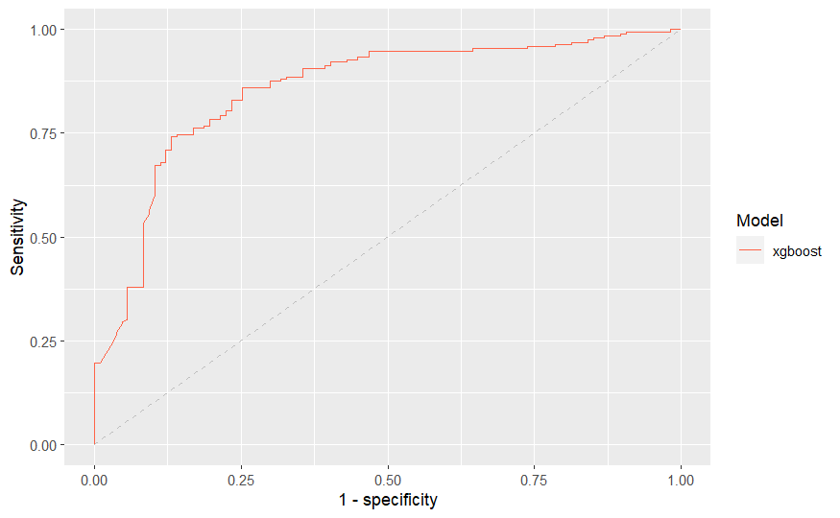
Boosting
AUC is .854

Slide 11
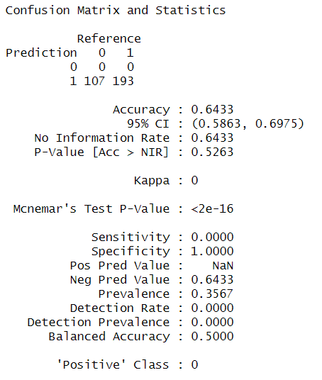
Naive Bayes
My data was frequency which conflicts with categorical requirements
Accuracy for the holdout was about .64

Slide 12
Conclusion
Using predictors regarding the grammar of sports articles, we can to some degree predict if the article will be objective.
Predictors such as interrogative words, quotes, past-tense verbs, and pronouns can impact objectivity
Limited by large amount of predictors and high correlation among predictors
Accuracy among models was close, but logistic regression accuracy on holdout was the highest at .8167

